Slide 1
Designing Experimentation Metrics
Somit Gupta & Pavel Dmitriev, Microsoft Analysis & Experimentation

Slide 2

Importance of right metrics
In 1902, the French quarter in Hanoi was overrun with rats. A "deratisation" scheme paid citizens for each rat they captured (the proof requested for payment was rat’s tail).
Rats Killed per day
1,000/day
4,000/day
April, 1902
April, 1902
20,000/day
Week 1
Week 2
July, 1902
But they barely made a dent in the problem!
Investigation revealed two phenomena:
Tailless rats started appearing
A thriving rat farming industry emerged in the city
https://community.redhat.com/blog/2014/07/when-metrics-go-wrong/
http://www.freakonomics.com/media/vannrathunt.pdf
https://en.wikipedia.org/wiki/Cobra_effect
Notes:
3 mins
What you measure is what you get
What you do not measure does not improve
Illustrates the problem with the OEC metric:
Short term metric
Inadequate ‘tail’-metry
Game-able
Sets the wrong incentives - GoodHart Law https://en.wikipedia.org/wiki/Goodhart%27s_law
No guardrails to counterbalance abuse of the metric
What would be a good success metric?
https://hbr.org/2010/06/column-you-are-what-you-measure
https://community.redhat.com/blog/2014/07/when-metrics-go-wrong/
http://www.freakonomics.com/media/vannrathunt.pdf
https://en.wikipedia.org/wiki/Cobra_effect

Slide 3
Experimentation Metrics Taxonomy
While analyzing the results of an experiment we compute many of metrics of different type and role.
Data Quality metrics
OEC (Overall Evaluation Criteria) metric
Guardrail metrics
Local feature and diagnostic metrics
A Dirty Dozen: Twelve Common Metric Interpretation Pitfalls in
Online Controlled Experiments
Principles for the design of online metrics
Data-Driven Metric Development for Online Controlled Experiments
Seven Rules of Thumb for Web Site Experimenters
Data Quality metrics • OEC metrics • Guard rail metrics • Local feature/Diagnostic metrics
Notes:
3:30

Slide 4
Data Quality metrics
Are the results trustworthy?
Sample Ratio Mismatch (SRM)
Data loss
Click reliability
Cookie churn
Data Quality metrics • OEC metrics • Guard rail metrics • Local feature/Diagnostic metrics
Notes:
5:00

Slide 5
OEC: Overall Evaluation Criteria
Was the treatment successful?
A single metric or a few key metrics
Two key properties:
Alignment with long-term company goals (Directionality)
Ability to impact (Sensitivity)
OEC vs KPIs (Key Performance Indicators)
KPIs are lagging metrics reported monthly/quarterly/yearly at the overall product level (DAU, MAU, Revenue, etc.)
OEC is a leading metric measured during the experiment (e.g. 2 weeks) at user level, which is indicative of long term increase in KPIs
Designing a good OEC is hard
Example: OEC for a search engine
http://www.exp-platform.com/Pages/hippo_long.aspx
http://bit.ly/expUnexpected
http://www.exp-platform.com/Pages/PuzzlingOutcomesExplained.aspx
http://www.exp-platform.com/Documents/2016CIKM_MeasuringMetrics.pdf
Data Quality metrics • OEC metrics • Guard rail metrics • Local feature/Diagnostic metrics
Notes:
9:00

Slide 6
OEC for Search
The two key search engine (Bing, Google) KPIs are Query Share (distinct queries) and Revenue
Should OEC be Queries/User and Revenue/User?
Example:
A ranking bug in an experiment resulted in very poor search results
Degraded (algorithmic) search results cause users to search more to complete their task, and ads appear more relevant
Distinct queries went up over 10%, and revenue went up over 30%
What metrics should be in the OEC for a search engine?
http://www.exp-platform.com/Pages/PuzzlingOutcomesExplained.aspx
Data Quality metrics • OEC metrics • Guard rail metrics • Local feature/Diagnostic metrics
Notes:
11:00

Slide 7
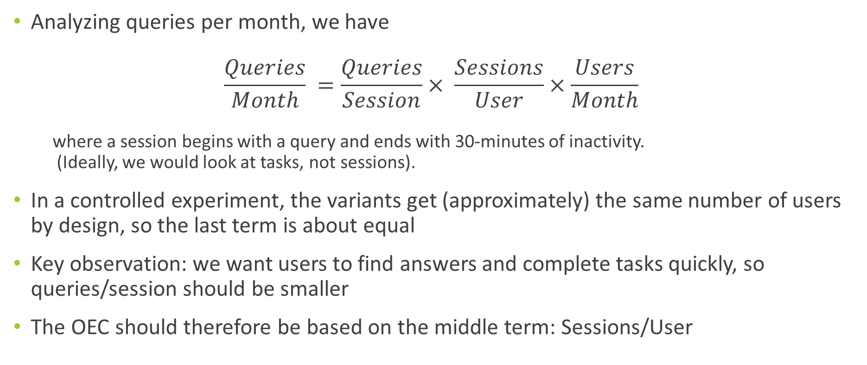
OEC for Search
Analyzing queries per month, we have $\frac{Queries}{Month} =\frac{Queries}{Session}× \frac{Sessions}{User}×\frac{Users}{Month}$
where a session begins with a query and ends with 30-minutes of inactivity. (Ideally, we would look at tasks, not sessions).
In a controlled experiment, the variants get (approximately) the same number of users by design, so the last term is about equal
Key observation: we want users to find answers and complete tasks quickly, so queries/session should be smaller
The OEC should therefore be based on the middle term: Sessions/User
Data Quality metrics • OEC metrics • Guard rail metrics • Local feature/Diagnostic metrics
Notes:
15:00

Slide 8
OEC for Search: Sensitivity
While Sessions/User has great directionality, it rarely moves in our experiments
Both because it is hard to change the pattern of user visits in a short term experiment, and because of its statistical properties
More on this later in the tutorial
The Search OEC we developed includes Sessions/User, but also adds other more sensitive surrogate metrics that are predictive of Sessions/User movement.
Surrogates are based on the concept of search success - how successful were users in their search tasks?
http://www.exp-platform.com/Pages/PuzzlingOutcomesExplained.aspx
Data Quality metrics • OEC metrics • Guard rail metrics • Local feature/Diagnostic metrics
Notes:
17:00

Slide 9
More OEC Examples
Netflix:
Subscription business
KPI: Retention (i.e. the fraction of users who return month over month)
OEC: Viewing Hours. Strong correlation between viewing hours and retention
Coursera:
Care about course completion, make money by users pay for certifications
KPIs: Course completions, # Certificates sold, Revenue
OEC: Test completion and Course engagement. Predictive of course completion and certificates sold
Examples are from “Designing with Data: Improving the User Experience with A/B Testing”
Notes:
19:00
Netflix: Because it is a subscription-based business, one of Netflix’s key metrics is retention, defined as the percentage of their customers who return month over month. Conceptually, you can imagine that someone who watches a lot of Netflix should derive a lot of value from the service and therefore be more likely to renew their subscription. In fact, the Netflix team found a very strong correlation between viewing hours and retention. So, for instance, if a user watched only one hour of Netflix per month, then they were not as likely to renew their monthly subscription as if they watched 15 hours of Netflix per month. As a result, the Netflix team used viewing hours (or content consumption) as their strongest proxy metric for retention, and many tests at Netflix had the goal of increasing the number of hours users streamed. (Kindle Locations 2206-2210)
Coursera: Coursera is a credential-driven business; in other words, they make money when users pay for credentials (certifications) after completing a course. One of their key metrics might be the number of credentials sold, or the revenue generated from credential purchases. You might be skeptical about this metric, though, and for good reason: because Coursera courses are often 13-week college classes, measuring how a design changes this metric would take far too long to be practical...Course completion is predicted by module completion, which is in turn predicted by test completion and how often a user engages with a course. So Coursera measures test completion or course engagement as proxies for their key metric, allowing them to cut down the time to measure the impact of a design change dramatically. (Kindle Locations 1266-1269)

Slide 10
How to come up with the right OEC?
In the beginning:
Start simple: frequency of user visits can be a good indicator of user happiness
Evaluate and improve based on “learning experiments”:
An obviously positive change: that will clearly increase user happiness like removing ads
An obviously negative change: like adding latency or decreasing relevance of search results
Continue to improve directionality and sensitivity over time:
Setup a metric evaluation framework: curate a diverse set of labeled experiments agreed to be positive, negative or neutral with respect to long-term value. Test changes to the OEC on this set.
http://www.exp-platform.com/Documents/2016CIKM_MeasuringMetrics.pdf
Data Quality metrics • OEC metrics • Guard rail metrics • Local feature/Diagnostic metrics
Notes:
21:00

Slide 11
Experimentation Metrics Taxonomy
While analyzing the results of an experiment we usually compute 1000’s of metrics of different type and role.
Data Quality metrics
Are the results trustworthy?
e.g. Sample Ratio Mismatch
OEC (Overall Evaluation Criteria) Metric
Was the treatment successful?
e.g. Sessions/User
Guardrail metrics
Did the treatment cause an unacceptable harm to key metrics?
e.g. KPI metrics, Performance metrics, short-term Revenue
Local feature and diagnostic metrics
Why the OEC and guardrail metrics moved or did not move?
e.g. number of impressions and clicks on a feature/button/link
Data Quality metrics • OEC metrics • Guard rail metrics • Local feature/Diagnostic metrics
Notes:
23:00

Slide 12
Summary
Having good metrics is critical
“You get what you measure”
Metrics have different types and roles in the analysis of an experiment
Data Quality metrics, OEC metric, Guardrail metrics, Local feature/Diagnostic metrics
The Challenge of designing a good OEC
A leading metric measured in a ~2 week period but indicative of long term goals
Start simple and continuously improve over time
Notes:
25:00

Slide 13
Questions?
http://exp-platform.com

Slide 14
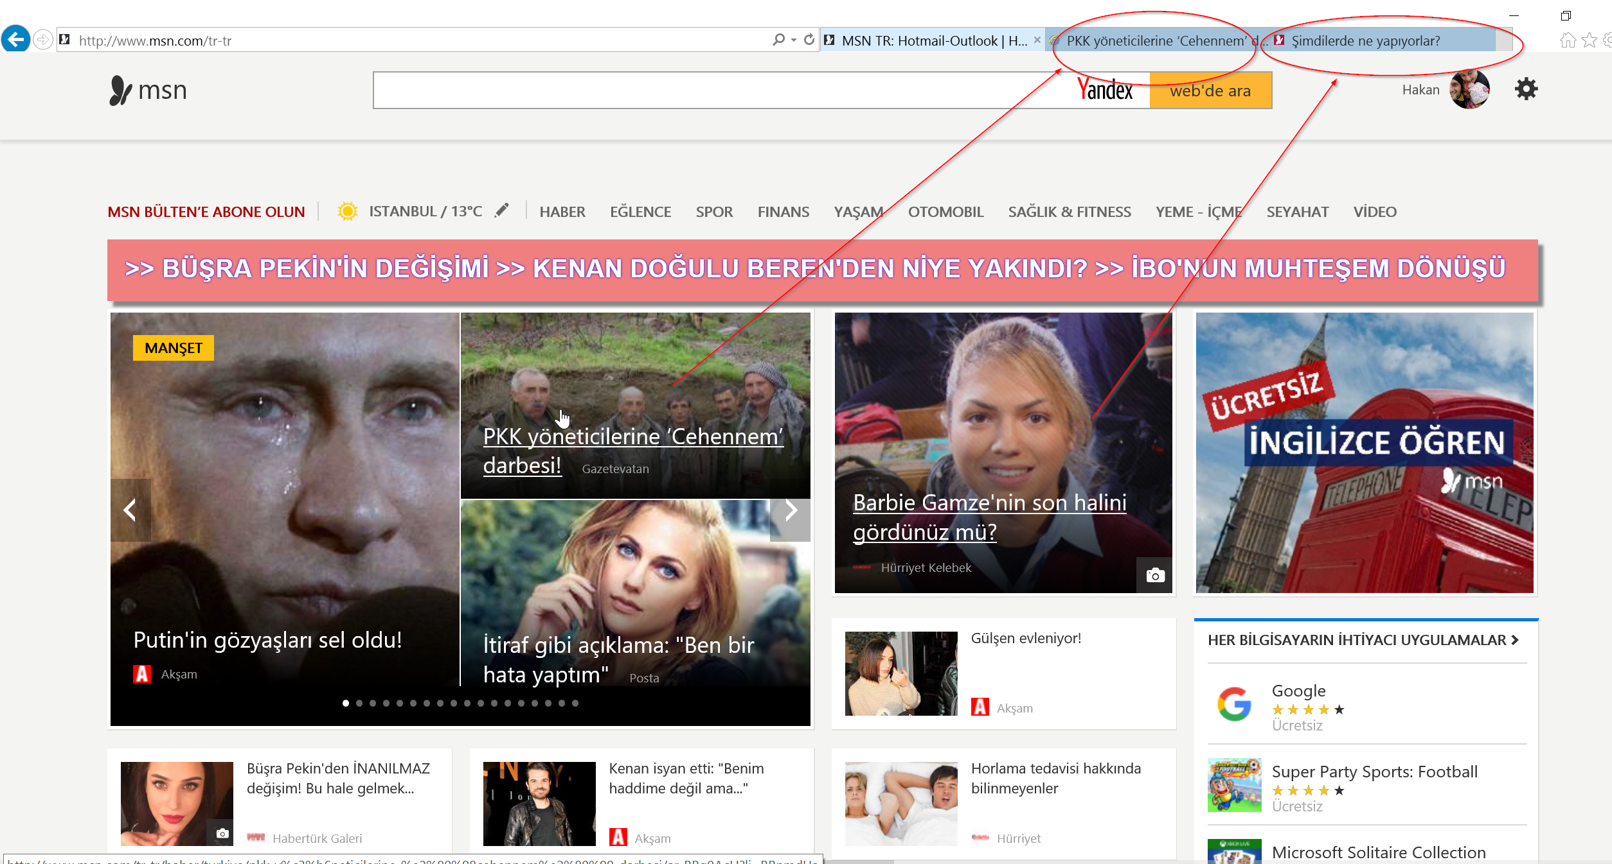

Pitfalls in Metric Interpretation
The situations when the experiment was configured and run correctly, but we can still misinterpret the metrics and end up with a wrong conclusion
“A Dirty Dozen: Twelve Common Metric Interpretation Pitfalls in Online Controlled Experiments” will be presented at KDD 2017 next week.
Puzzling example: treatment made a 1-line Javascript change to open links on MSN homepage in a new tab. The experiment showed ~8% increase in MSN homepage load time.
Treatment
Control
Notes:
SIGIR version

Slide 15
Pitfalls in Metric Interpretation
The situations when the experiment was configured and run correctly, but we can still misinterpret the metrics and end up with a wrong conclusion
“A Dirty Dozen: Twelve Common Metric Interpretation Pitfalls in Online Controlled Experiments” will be presented at KDD 2017 next week.
Puzzling example: treatment made a 1-line Javascript change to open links on MSN homepage in a new tab. The experiment showed a large increase in MSN homepage load time.
Metric-level SRM. The treatment has fewer repeated homepage loads which are usually faster than the first homepage load due to caching. The comparison between the treatment and control population for time to load is not fair & no causal inference can be drawn.
Lessons: alert on metric-level SRMs
Notes:
SIGIR version
2:45

Slide 16
Pitfalls in Metric Interpretation
The situations when the experiment was configured and run correctly, but we can still misinterpret the metrics and end up with a wrong conclusion
Attend our talk on Thursday 10am, session AT7, room 200C: “A Dirty Dozen: Twelve Common Metric Interpretation Pitfalls in Online Controlled Experiments”
Puzzling example: treatment made a 1-line Javascript change to open links on MSN homepage in a new tab. The experiment showed ~8% increase in MSN homepage load time.
Treatment
Control
Notes:
KDD version

Slide 17
Pitfalls in Metric Interpretation
The situations when the experiment was configured and run correctly, but we can still misinterpret the metrics and end up with a wrong conclusion
Attend our talk on Thursday 10am, session AT7, room 200C: “A Dirty Dozen: Twelve Common Metric Interpretation Pitfalls in Online Controlled Experiments”
Puzzling example: treatment made a 1-line Javascript change to open links on MSN homepage in a new tab. The experiment showed ~8% increase in MSN homepage load time.
The treatment has fewer repeated homepage loads which are usually faster than the first homepage load due to caching. The comparison between the treatment and control population for time to load is not fair & no causal inference can be drawn.
Lessons: alert on metric-level SRMs, decompose the metrics
To learn more attend the talk or read the paper!
Notes:
KDD version

